Slide 1
Paper and Pulp key statistics
Labid GHODHBANI

Slide 2
Issues

Slide 3
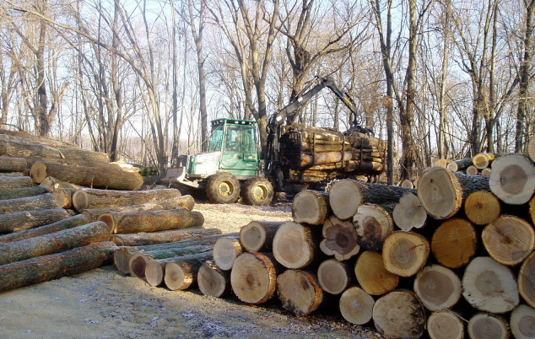
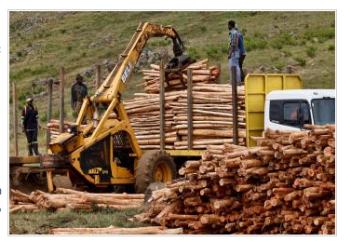
Issues and Problem
There are several problems and issues for making paper and paper products :
Major cause of damage to tropical forest.
40% of the world’s industrial logging goes into making paper, and this is expected to reach 50% in the near future.
The major wood product consumption by 2060 will be in pulp and paper.

Slide 4
Feedbacks
Environmental Aspects
Energy Aspects
Worldwide consumption of paper has risen by 400%
The growth of paper product is
126 %
40% of harvested trees being used for paper manufacture
The pulp and paper industry is the fourth largest industrial user of energy, accounting for 4% of all the world’s energy use.

Slide 5
Benefits from virgin to recycled paper
Reduces Total energy by 27%
Reduces Wood use by 100%
Reduces wastewater by 33%
Reduces green gas emission by 47%

Slide 6
How much energy is saved?
Operations & Logistics

Slide 7
30% Recycled Paper ( 1ton)
7.2 trees
2,100 gallons of water
Benefits
1,230 kwh of electricity, 18 pounds of air pollution

Slide 8
100% Recycled Paper ( 1ton)
24 trees
7000 gallons of water
benefits
4100 Kw of electricity per ton, 18 pounds of air pollution

Slide 9
The World’s Market

Slide 10
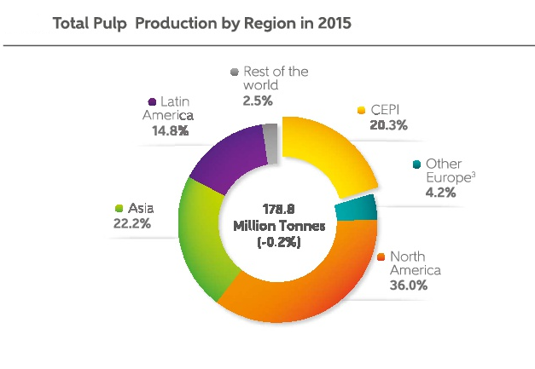
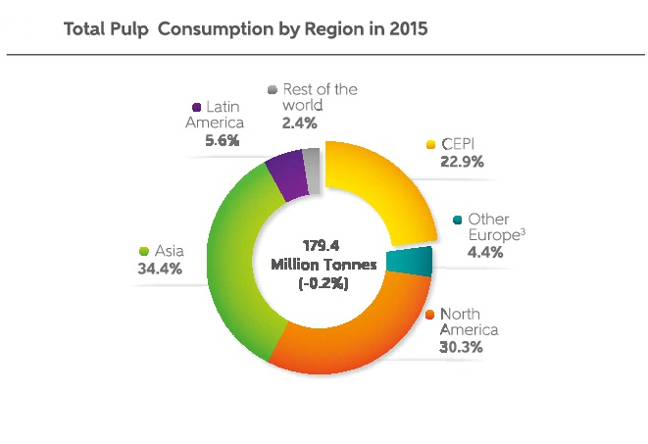
Production and consumption attractiveness
Consumption
Production

Slide 11
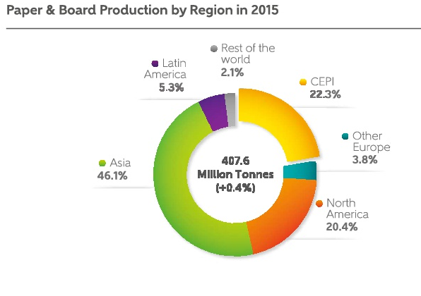
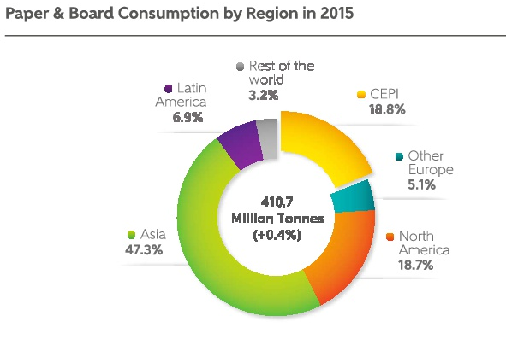
Production and consumption attractiveness
2016: Growth of the world paper market 0,8%

Slide 12
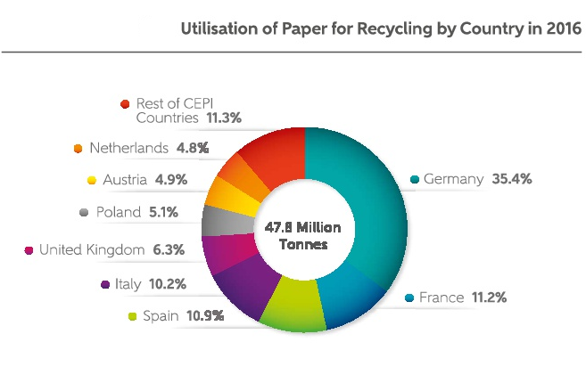
Use of recycled paper
2015: Growth of the world recycled paper market - 0,3%

Slide 13
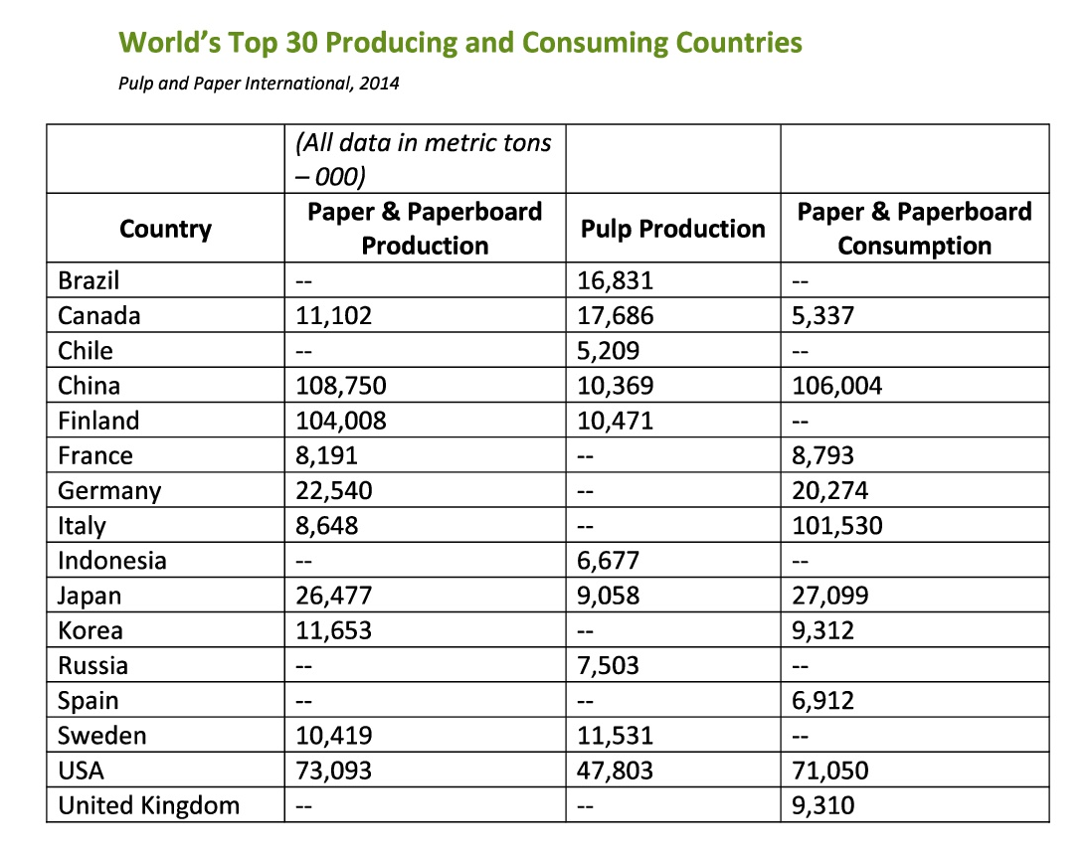
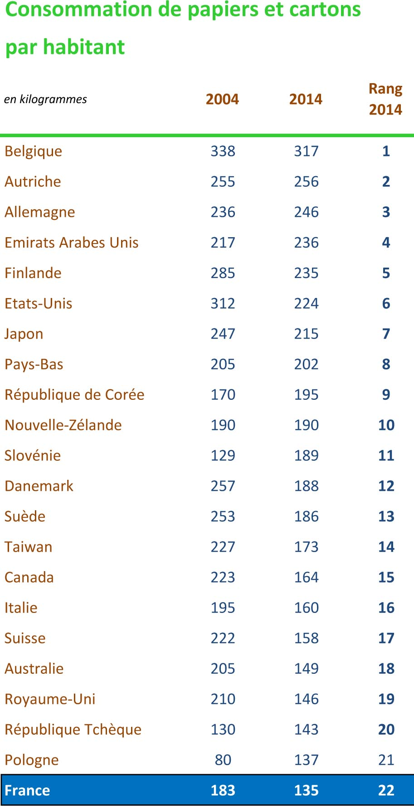
Top Production and consumption Countries

Slide 14
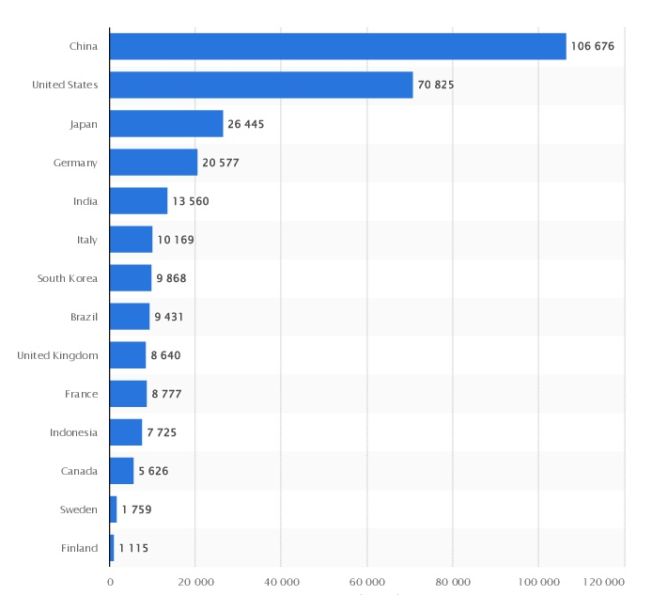
perspectives
Consumption of paper and paperboard in selected countries worldwide in 2016 (in 1,000 metric tons)

Slide 15
The Arabic Market

Slide 19
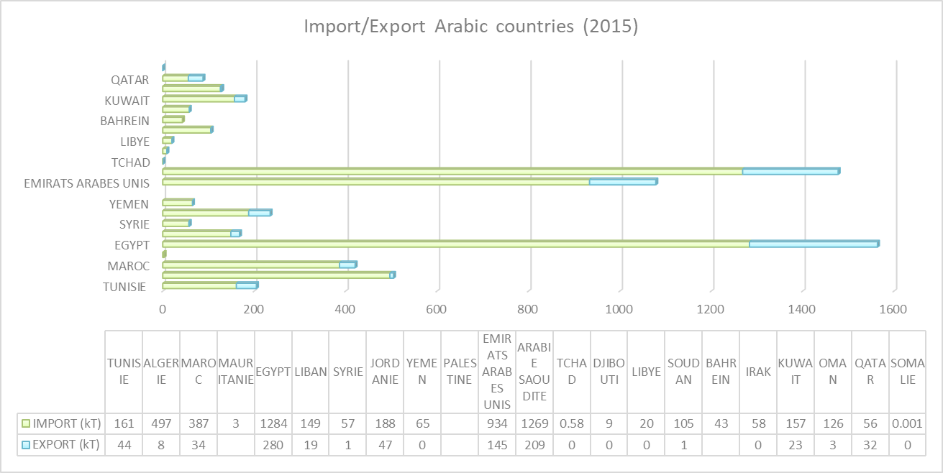
ImportAtion/Exportation

Slide 20
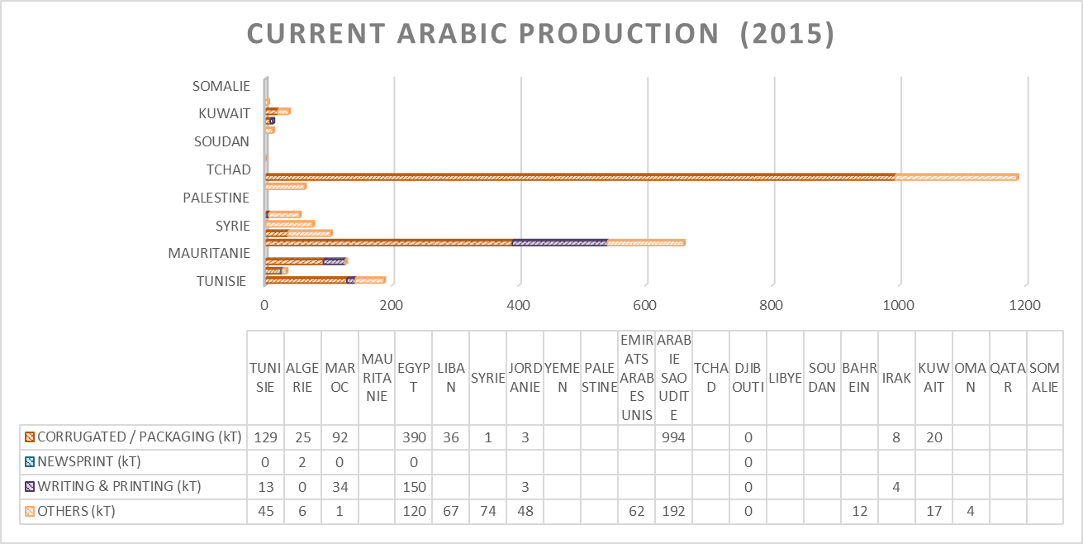
Production In ARABIC MARKET

Slide 21
Perspective & Conclusion

Slide 22
Conclusion & Perspectives
Arabic paper Market proves that Importation is almost more than 4 times
Exportation . (Important Consumption)
For the future we need to invest in recycled paper and energy ( Huge losses due to the lack of investment )
Some Arabic Markets could be considered as a big business opportunity. For the future the following trend could be corrugated and packaging paper
Total lack of Newsprinting industries ( Need of investment)

Slide 23
Thank You

